Slide 1
Javascript events
IN712 Web 3

Slide 2
JavaScript events
A JavaScript event is an action that can be detected by JavaScript
Many of them are initiated by user actions but some are generated by the browser itself
We say then that an event is triggered and then it can be caught by JavaScript functions, which then do something in response
In the original JavaScript world, events could be specified right in the HTML markup with hooks to the JavaScript code (and still can)
This mechanism was popular in the 1990s and 2000s because it worked
As more powerful frameworks were developed, and website best practices were refined, this original mechanism was supplanted by the listener approach

Slide 3
Types of events
Mouse events: mouse movement, clicking, double-clicking, dragging
Keyword events: a keyboard press, depress
Form events: when something in the form changes
Mutation events: when the DOM nodes are modified
Touch events: when the user touches the sensor
Error events: when an error occurs
Frame events: are the events related to the browser frame that contains your web page (For instance, when the document loads)

Slide 4
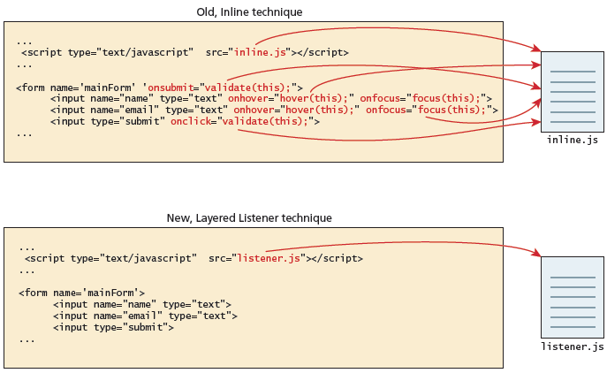
Connecting code to events - old and new technique comparison

Slide 5
In line event handler
JavaScript events allow the programmer to react to user interactions
In early web development, it made sense to weave code and HTML together
to this day inline JavaScript calls are intuitive
In the example the HTML attribute onclick is used to attach a handler to that event (event handler)
When the user clicks the <div>, the event is triggered and the alert is executed
The problem with this type of programming is that the HTML markup and the corresponding JavaScript logic are woven together
This reduces the ability of designers to work separately from programmers, and generally complicates maintenance of applications
The better way to program this is to remove the JavaScript from the HTML

Slide 6
Object property event handler
The design principle of layers is a proven way of increasing maintainability and simplifying markup.
The problem with the inline handler approach is that it does not make use of layers; that is, it does not separate content from behavior.

Slide 7

Listener approach event handler
The standard technique for listening for events
The only approach which is warranted to work in future browser versions
It’s biggest advantage is that you can register multiple event listeners for a single event on a single element

Slide 8
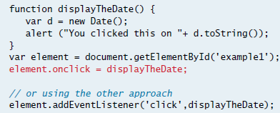
Listening to an event with a function

Slide 9

Listening to an event with an anonymous function

Slide 10

Event object
No matter which type of event we encounter, they are all DOM event objects and the event handlers associated with them can access and manipulate them
Typically we see the events passed to the function handler as a parameter named e

Slide 11
Event object
These objects have many properties and methods.
Many of these properties are not used
but several key properties and methods of the event object are worth knowing
Bubbles: The bubbles property is a Boolean value. If an event’s bubbles property is set to true then there must be an event handler in place to handle the event or it will bubble up to its parent and trigger an event handler there
Cancelable. The Cancelable property is also a Boolean value that indicates whether or not the event can be cancelled
preventDefault. A cancelable default action for an event can be stopped using the preventDefault() method

Slide 12

A sample event handler function that prevents the default event
the preventDefault()method is a common practice when you want to send data asynchronously when a form is submitted, for example, since the default event of a form submit click is to post to a new URL (which causes the browser to refresh the entire page).

Slide 13
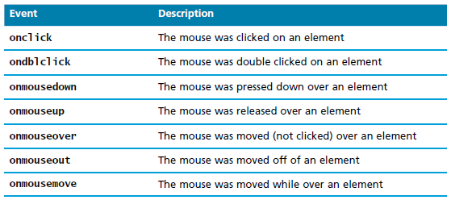
Mouse events
Mouse events are defined to capture a range of interactions driven by the mouse
These can be further categorized as mouse click and mouse move events

Slide 14
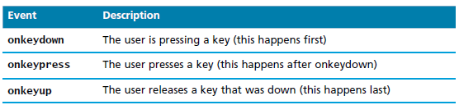
Keyboard events
These events are most useful within input fields.
We could for example validate an email address, or send an asynchronous request for a dropdown list of suggestions with each key press

Slide 15
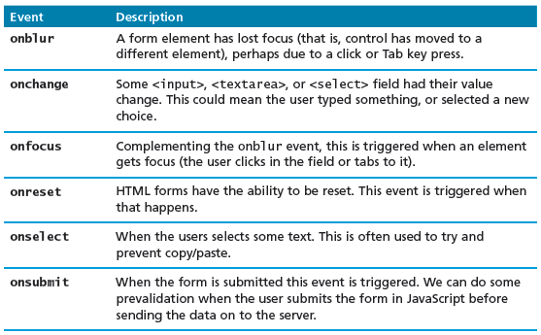
Form events
Forms are the main means by which user input is collected and transmitted to the server
The events triggered by forms allow us to do some timely processing in response to user input
The most common JavaScript listener for forms is the onsubmit event

Slide 16
Frame events
Frame events are the events related to the browser frame that contains your web page
The most important event is the onload event, which tells us an object is loaded and therefore ready to work with.
In fact, every nontrivial event listener you write requires that the HTML be fully loaded
However, a problem can occur if the JavaScript tries to reference a particular <div> in the HTML page that has not yet been loaded
If the code attempts to set up a listener on this not-yet-loaded <div>, then an error will be triggered
For this reason it is common practice to use the window.onload event to trigger the execution of the rest of the page’s scripts

Slide 17

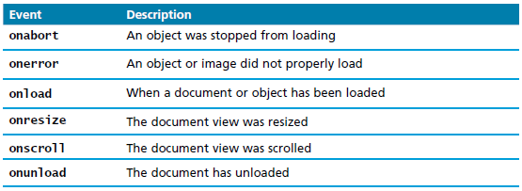
Frame events

Slide 18
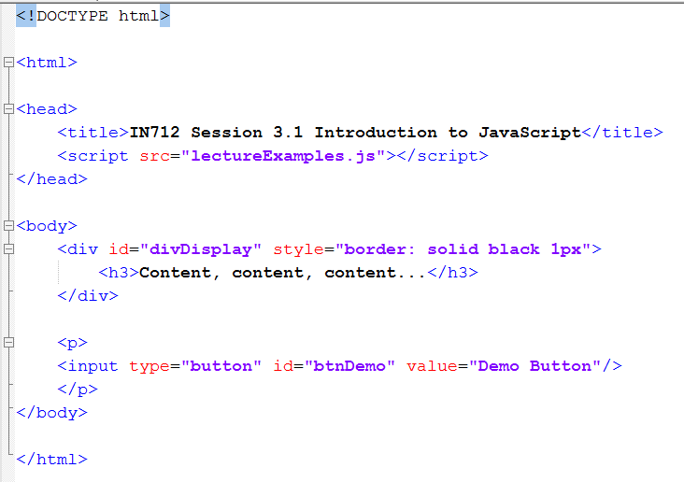
Event Handlers examples

Slide 19
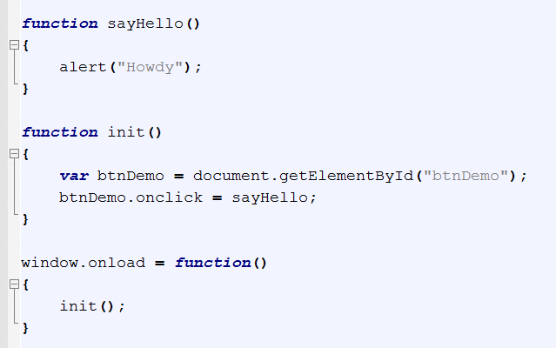
window.onload

Slide 20
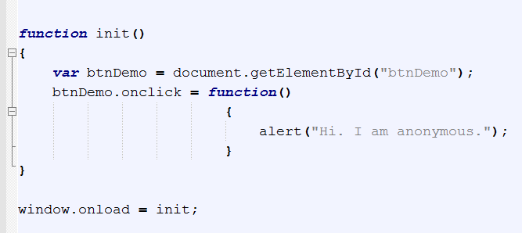
Alternative Syntactic Option

Slide 21
Demo
http://liveweave.com/joSXJW

